Slide 1


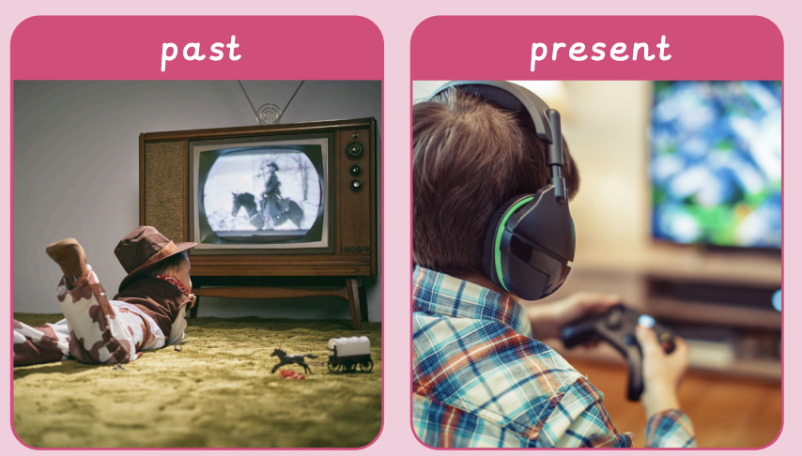


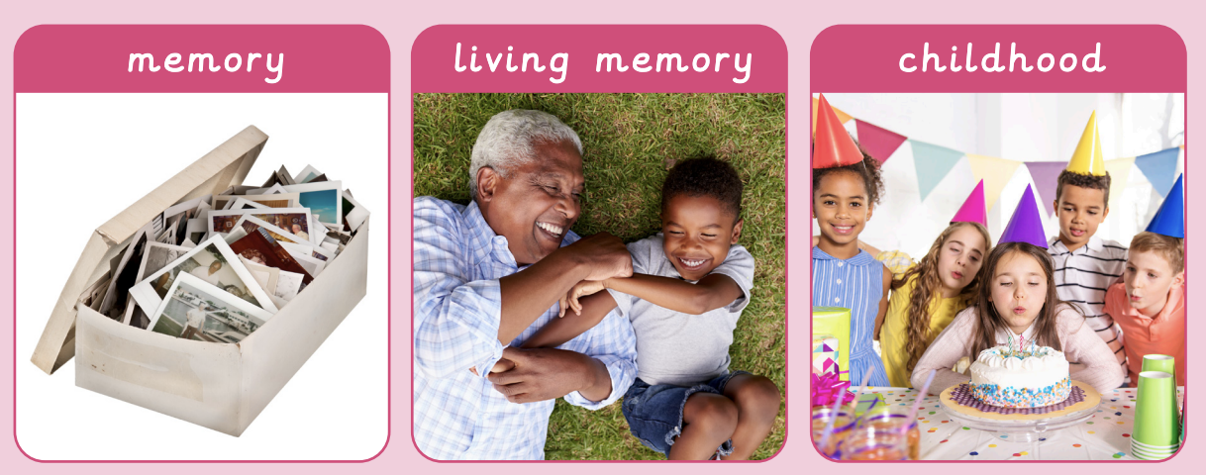


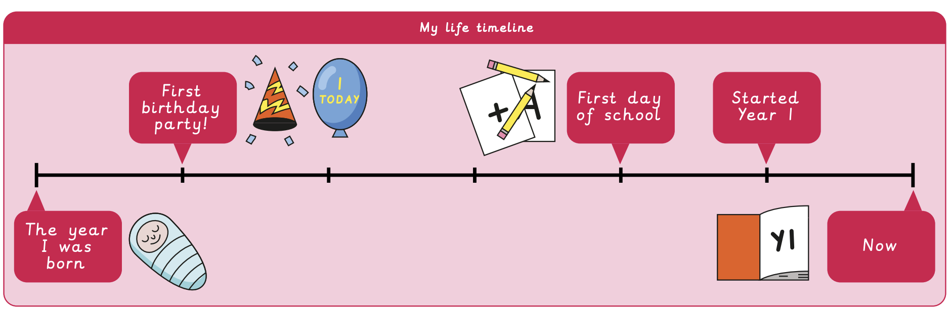



How am I making history? | Sapphire Year A | History | Autumn
What I should already know:
Know some similarities and differences between things in the past and now
Comment on images of familiar situations in the past
What I will learn:
LO 1: What is my history?
LO 2: How can I find out more about myself?
LO 3: How are special events remembered?
LO 4: What was it like for children in the past?
LO 5: What have I learnt about children in the past?
LO 6: How am I making history?
Key Vocabulary:
celebrate |  | To do something fun because of an event
childhood |  | Time spent as a child
family |  | A group of people who love and care for each other
future |  | Time still to come
lifetime |  | The duration of a person’s life
memory |  | Something remembered from the past
past |  | Events that have already happened
present |  | What is happening now
timeline |  | A line to show the order of important events in the past
Sapphire

