Slide 1
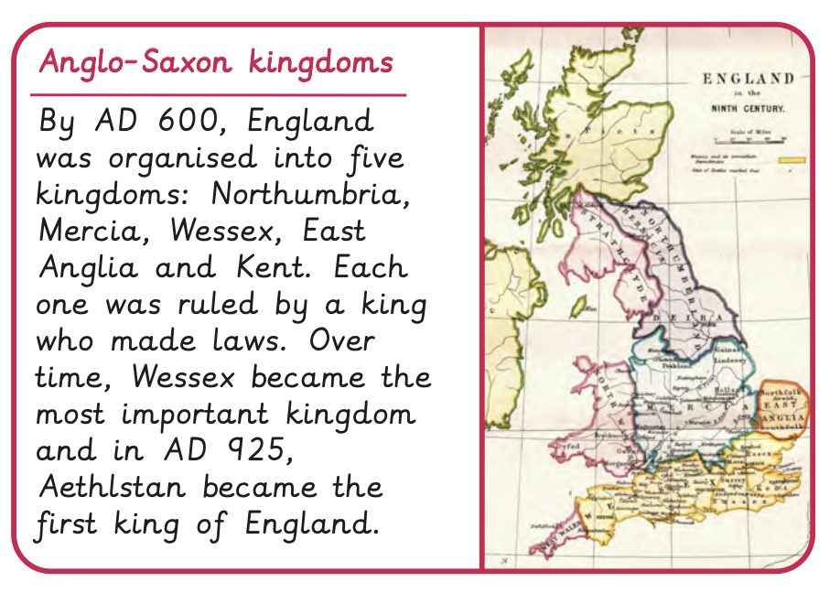
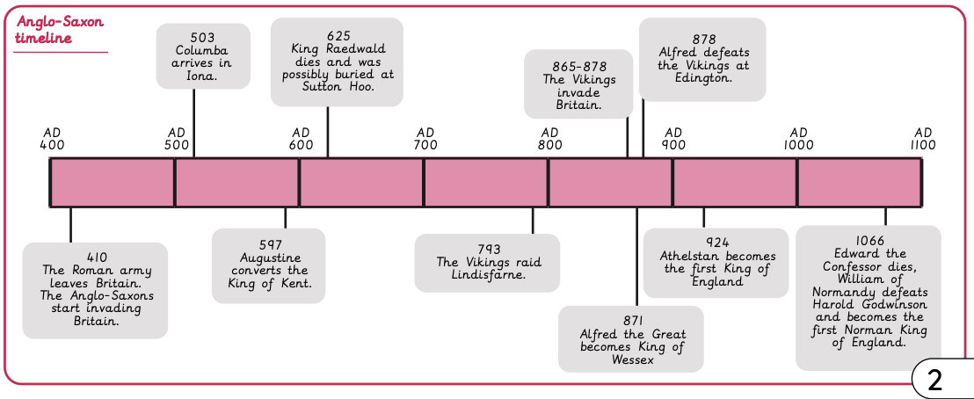
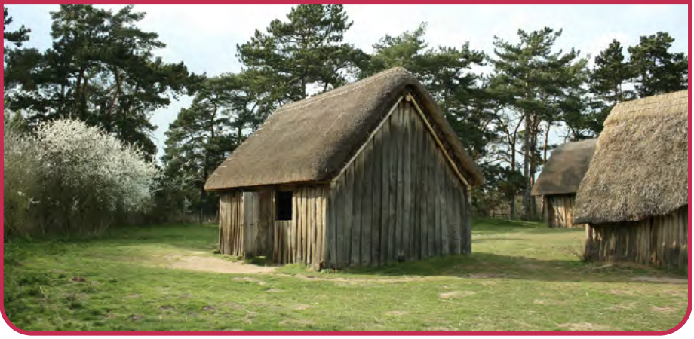

Anglo-Saxons | Diamond Year A | History | Summer
What I should already know:
How to sequence events on a timeline
Life in Britain has changed over time
Significant archaeological finds are how we see the past
What I will learn:
LO 1: Who were the Anglo-Saxons and the Scots?
LO 2: What did Anglo-Saxon settlements look like?
LO 3: What does Sutton Hoo tell us about Anglo-Saxon life?
LO 4: How did Christianity arrive in Britain?
LO 5: Was King Alfred really ‘Great’?
LO 6: How did Anglo-Saxon rule end?
Key Vocabulary:
claimant | A person who believes they are entitled to be the king or queen.
inference | A conclusion reached by using evidence
invasion | A military attack in which an army uses force to take over another country.
kingdom | A part of England which was ruled by a king or queen.
missionary | A person sent to an area to promote Christianity.
oath | A solemn promise
settlement | A place where a community of people live
settlers | People who move to a new country and stay there permanently.
Viking raids | Attacks on Britain in which the Vikings landed to steal items.
Vikings | Seafaring people from Scandinavia who raided and invaded Britain.
Significant People:
St. Columba (521AD -597AD) Founded a monastery on the island of Iona and spread Christianity in Scotland.
St. Augustine (530AD – 604AD) A Chrisitan missionary sent from Rome. Established a church in Canterbury.
St Aiden (590AD – 651AD) Became a missionary in Northumbria, founding the monastery in Lindisfarne.
Alfred the Great (849AD – 899AD) Fought and defeated the Vikings in 878AD. Improved standards of living and military systems in Britain.

