Slide 1
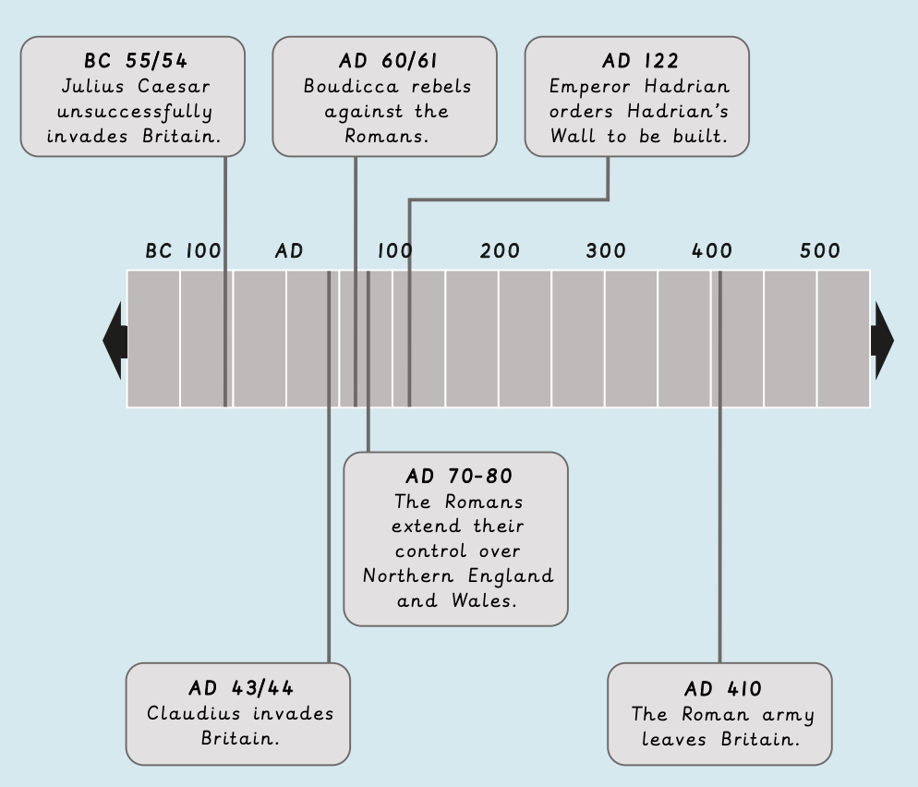

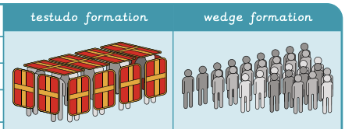
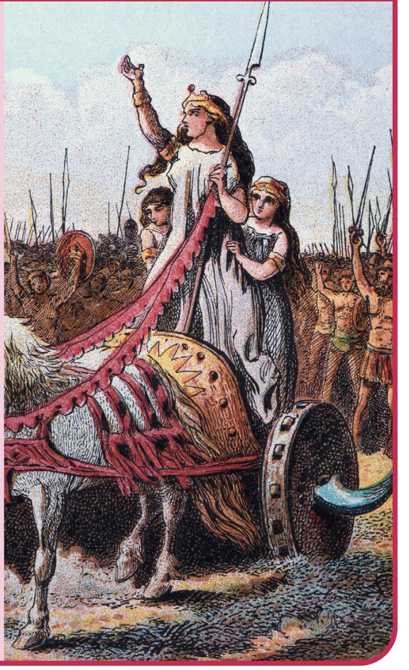
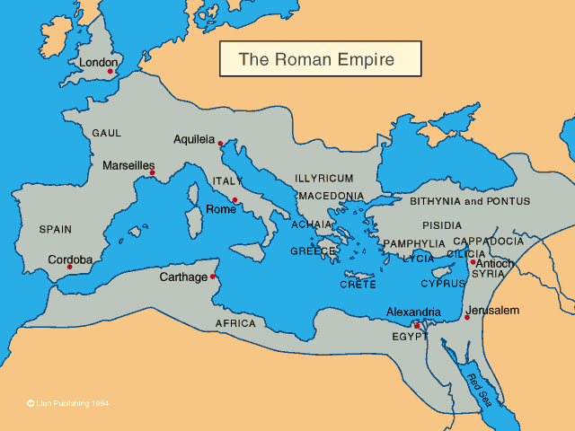
The Romans | Diamond Year A | History | Spring
What I should already know:
After the Stone Age came the Bronze Age then Iron Age.
People in Britain were living in small communities in towns and villages.
History is divided into periods of history e.g. ancient times, middle ages and modern
What I will learn:
LO 1: What was it like to live in Ancient Rome?
LO 2: Why did the Romans invade and settle in Britain?
LO 3: How did Britons respond to the Roman invasion?
LO 4: Why was the Roman army so successful?
LO 5: What do artefacts suggest about the lives of Roman soldiers in Britain?
LO 6: What was the legacy of the Roman Empire in Britain?
Key Vocabulary:
empire | Many countries ruled by one country or ruler.
inference | A conclusion reached by using evidence.
invasion | A military attack in which an army or country uses force to take over another country on the future.
legacy | Something that a historical person or group of people did which has a lasting impact on the future.
Romans | People (or objects) who originated from the city of Rome.
settlers | People who move to a new country and stay there permanently.
Significant People:
Julius Caesar (100BC – 44BC) Roman general who failed to conquer Britain twice
Claudius (10BC – 54AD) The first Roman emperor to successfully conquer Britain in 43BC
Hadrian (76AD – 138AD) Roman Emperor known for building Hadrian’s wall which marked the northern limit of Britian
Boudicca (30AD – 61AD) Queen of the Iceni tribe who led a rebellion against the Romans

