Slide 1
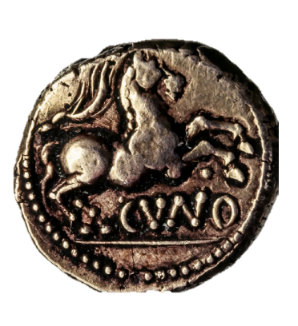
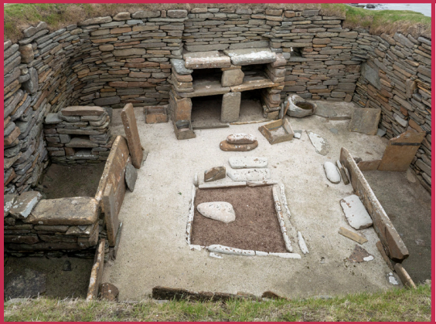
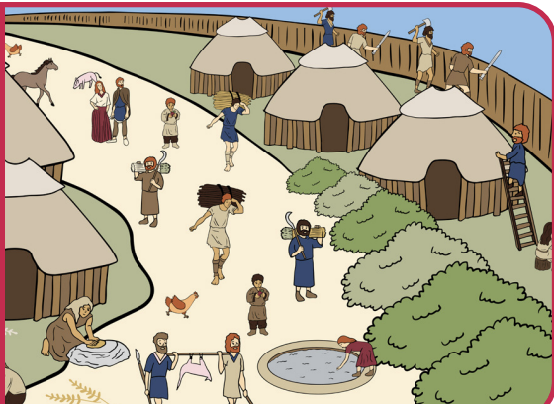
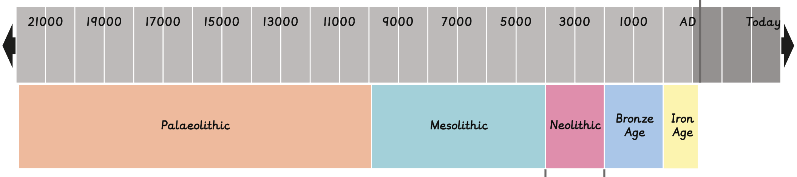
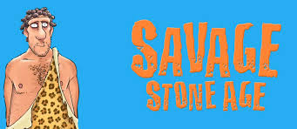
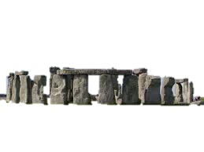
Stone Age to Iron Age | Diamond Year A | History | Autumn
What I should already know:
That history is divided into different periods of time.
A timeline shows the order of events in the past happened.
There are similarities and differences between our lives today and lives in the past.
What I will learn:
LO 1: How long ago did prehistoric man live?
LO 2: What does Skara Brae tell us about life in the Stone Age?
LO 3: Who was this Bronze Age man?
LO 4: What was the impact of bronze in prehistoric Britain?
LO 5: How did trade change lives in Iron Age Britain?
LO 6: What changed between the Stone Age and Iron Age?
Key Vocabulary:
AD (Anno Domini) | The Latin for ‘in the Year of the Lord’. A term to used to date the years after Jesus was born.
archaeology | Using remains to learn about the past.
barter | To exchange goods without using money.
BC (Before Christ) | A term used to date the years before Jesus was born.
hunter-gatherers | A group of people who move around hunting or collecting food.
settlement | A place where people live together as a community.
trade | The buying, selling and exchanging of objects and work.
tribe | A group of people with shared values and one leader.
Significant People:
Cheddar Man: The oldest complete skeleton found in Britain.

