Slide 1
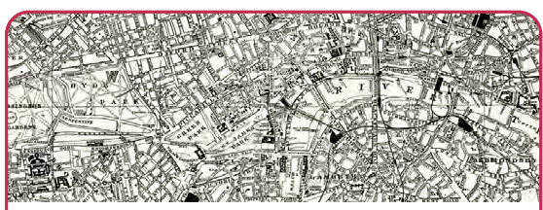
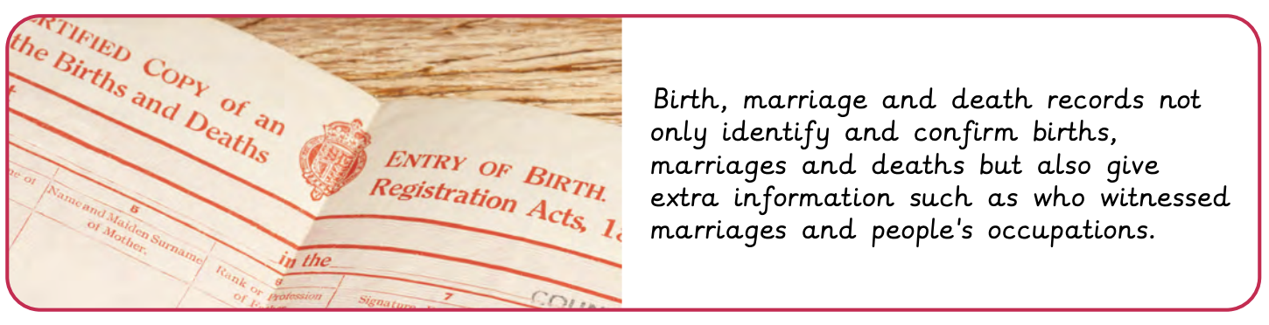
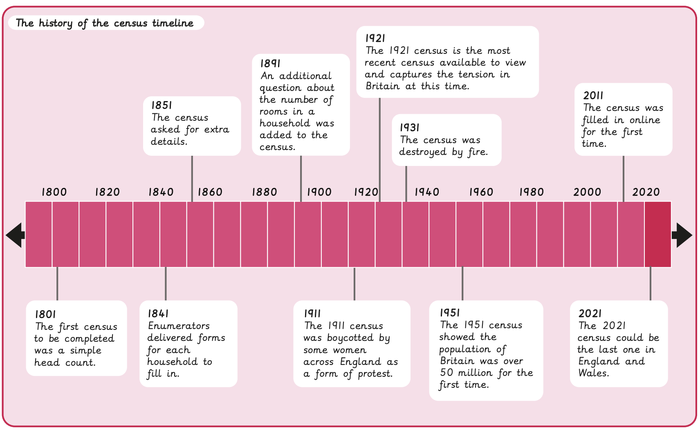
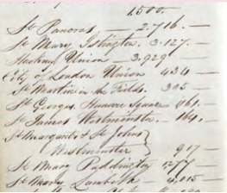
Census | Emerald Year A | History | Summer
What I should already know:
Describe changes over time
How to use a range of sources to find out about a particular aspect of the past
Using evidence to support and illustrate claims
What I will learn:
LO 1: What is the census?
LO 2: What can we learn about Victorian children from the census?
LO 3: What does the census suggest about the jobs available in the 1800s?
LO 4: Why did some women refuse to fill out the census in 1911?
LO 5: What changed in the 1921 census?
LO 6: Who lived in our local area in the past?
Key Vocabulary:
census | An official survey recording information about a population
decade | Ten years
Head of Household | The main person responsible for earning money and making important decisions for the household
historical enquiry | The process of investigating the past by asking questions, examining sources and piecing together how things happened
inference | Using the clues in sources to form an idea
local history | The study of the history of an area, looking at its past events, people and changes over time
occupation | A person’s job or profession
politics | Activities or ideas involved in making decisions for a country, city or group
reliable | Something or someone that can be trusted
suffrage | The right to vote in political elections
Significant People:
John Rickman (1771-1840) Created the first census
Office for National Statistics (ONS) Responsible for running the census in England and Wales

