Slide 1
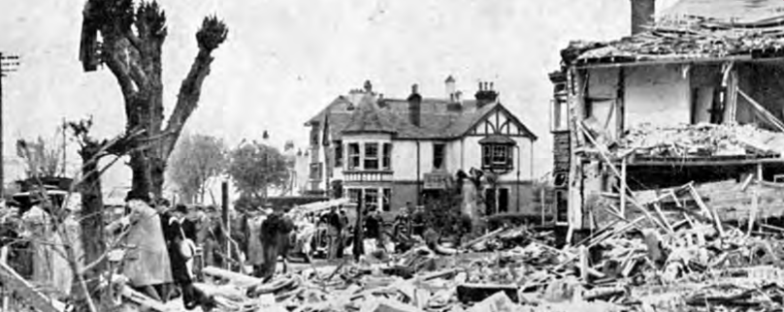
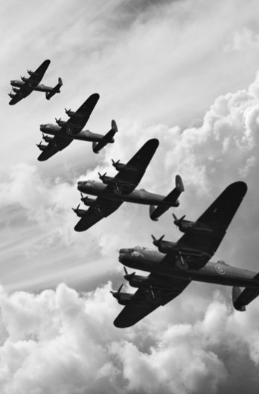

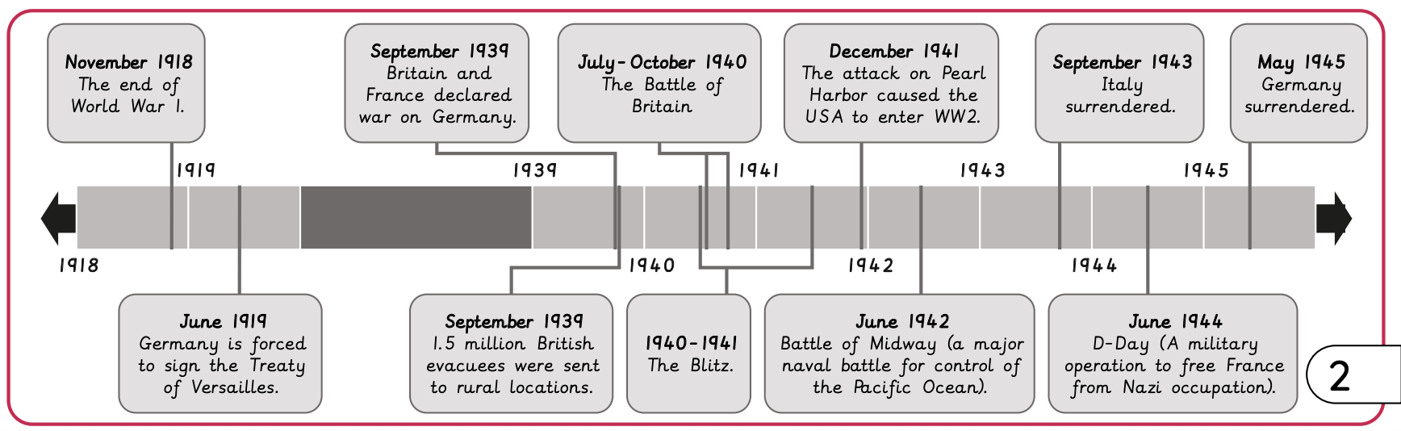
World War 2 | Emerald Year A | History | Spring
What I should already know:
Historical periods have characteristics that distinguish them
People in the past were as inventive and sophisticated in thinking as people today
Empires decline for different reasons
What I will learn:
LO 1: Why did Britain go to war in 1939?
LO 2: How did the Battle of Britain affect the Royal Air Force?
LO 3: What do sources tell us about the Blitz?
LO 4: What was evacuation like?
LO 5: Did World War 2 change women’s roles?
LO 6: Why did people migrate to Britain during and after World War 2?
Key Vocabulary:
advancement | The act of progressing and moving forward
alliance | People from different places sharing and learning about each other’s way of life
appeasement | Giving in to the demands of others to keep the peace and avoid war.
cause | The reason for an action or event
conflict | A disagreement or argument between people, groups or countries, often resulting in violence or war
cultural exchange | People from different places sharing and learning about each other’s way of life
Nazi Party | The political group in Germany, which often shared harmful and extreme ideas
propaganda | Information given out that may not be accurate which is intended to make people believe something or hold a particular point of view
Windrush generation | Caribbean people who came to the UK between 1948 and 1971
Significant People:
Adolf Hitler (1889-1945) The leader of the Nazi party and chancellor of Germany
Sir Winston Churchill (1874-1965) British Prime Minister who led the country to victory in World War 2.

