Slide 1
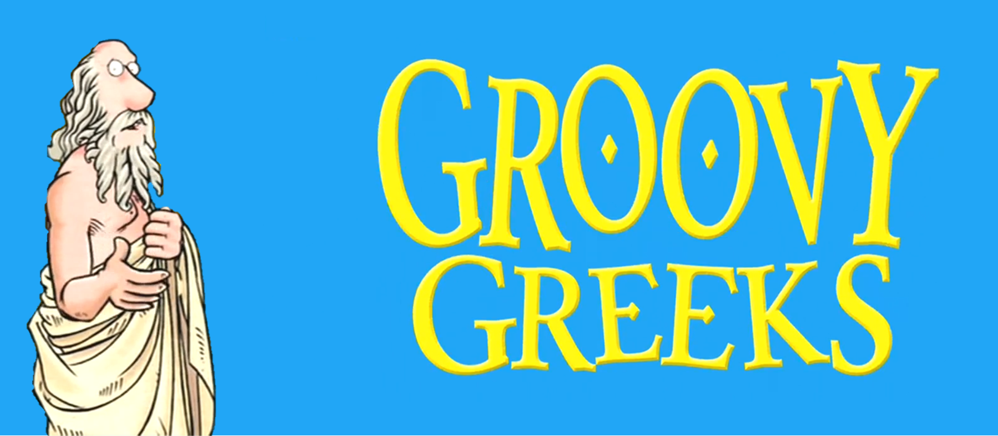
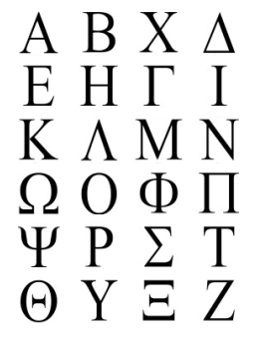
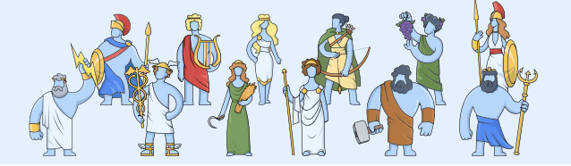
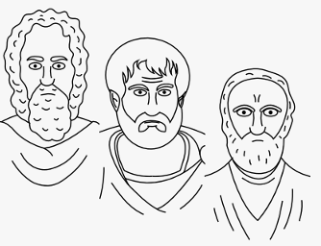
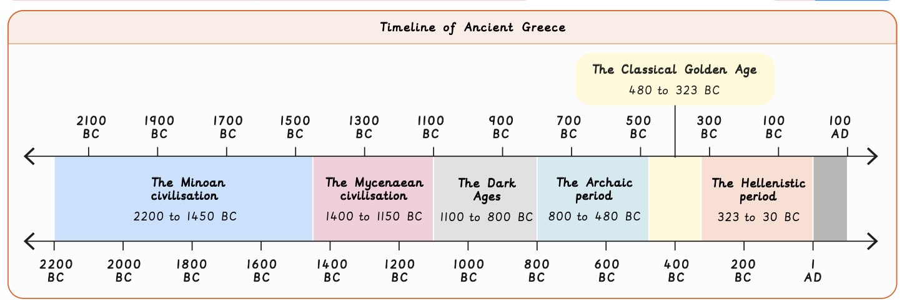
Ancient Greeks | Emerald Year A | History | Autumn
What I should already know:
How to make links to different time periods
How to sequence a period of history chronologically
How to use a range of sources to give conclusions about how people lived
What I will learn:
LO 1: Who were the Ancient Greeks and when did they live?
LO 2: Who lived on Mount Olympus?
LO 3: How was Ancient Greece governed?
LO 4: Did the Ancient Greeks give us democracy?
LO 5: How do the Ancient Greek philosophers influence us today?
LO 6: What is the legacy of the Ancient Greeks?
Key Vocabulary:
achievement | A significant accomplishment or contribution that had a lasting impact.
assembly | A democratic organisation in Ancient Athens where all men could vote on laws.
Athens | The largest and one of the most influential city-states in ancient Greece.
citizen | A person who belongs to a country and has certain rights and responsibilities
Classical Golden period | The period from 480BC to 323BC in which the Greeks built temples, created democracy and made scientific discoveries
democracy | A government elected by the citizens.
direct democracy | A system of government in Ancient Greece which gave all men the right to vote.
legacy | Past events or actions which have had a lasting impact.
oligarchy | A system of government in Ancient Greece in which only a few people had power
philosophy | The ‘love of wisdom’ in which people think and ask basic questions about human life.
Sparta | One of the most powerful city-states in Ancient Greece, known for its fierce army.
Significant People:
Zeus In Greek mythology, the god of the sky and supreme ruler of the Olympian gods
Greek philosophers Pythagoras – created the first maths formula Socrates – developed Socrates method used to discuss ideas Plato – his ideas on ethics are still debated today Aristotle – laid foundations for modern science

