Slide 1
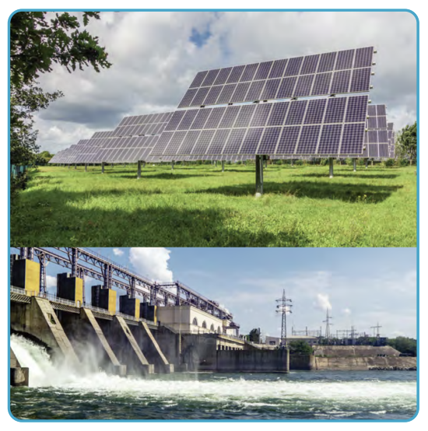
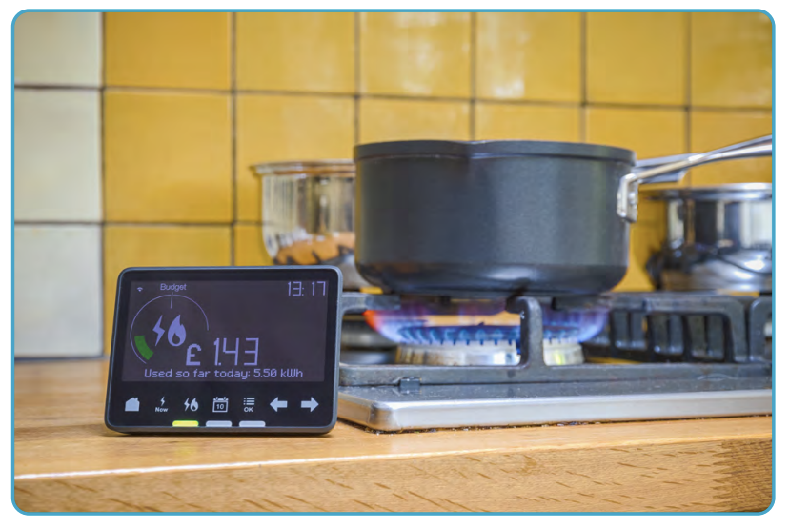
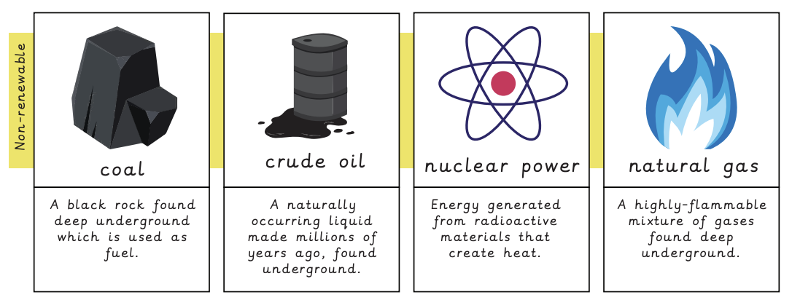
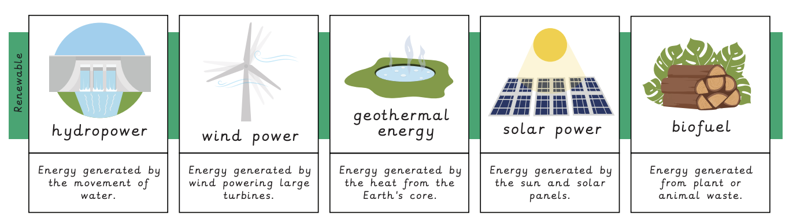
Where does our energy come from? | Emerald | Geography | Summer
What I should already know:
The names and locations of continents, countries and major rivers, oceans and different climate zones.
To be able to use and interpret maps at various scales (local, national and global).
Understand that humans have a positive and negative impact on the environment and give examples.
What I will learn:
LO 1: Why is energy important?
LO 2: What is renewable energy?
LO 3: How does the United States generate energy?
LO 4: How does the United Kingdom generate energy?
LO 5: What is the best way to generate energy?
LO 6: Where is the best place for a solar panel on the school grounds?
Key Vocabulary:
biofuel | Energy generated from plant or animal waste: a renewable source.
consumption | To use something up.
dam | A barrier used to hold back water.
emissions | The release of gas.
non-renewable | Cannot be replenished and will run out.
Prime Meridian | The line of zero degrees longitude that defines all time zones.
regenerate | To appear again once used.
renewable | Does not reduce in amount when used.
urban planner | Somebody whose job it is to plan new settlements.

