Slide 1
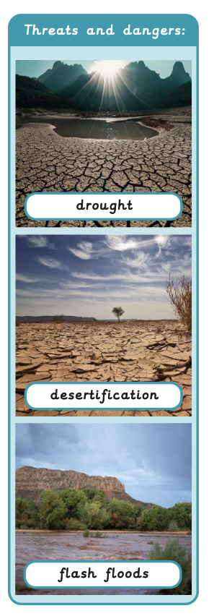
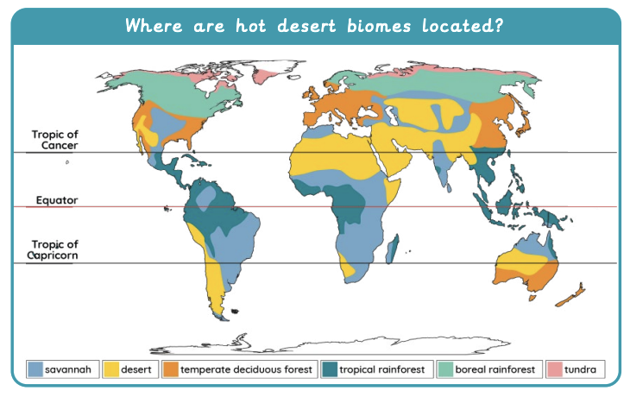
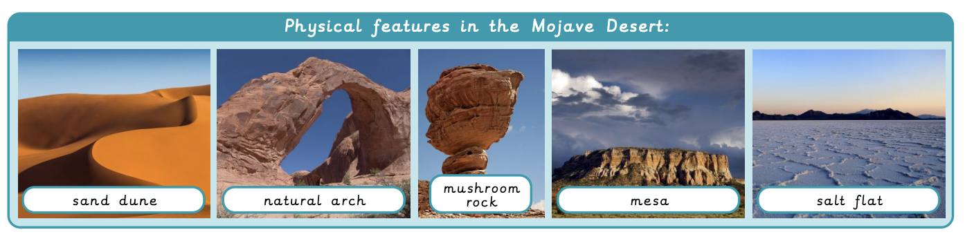
Would you like to live in the desert? | Emerald | Geography | Spring
What I should already know:
Understand the water cycle and its processes
Recognise different types of landforms such as mountains, coasts and rivers.
Where specific places are, including continents, countries and use key vocabulary to describe them.
What I will learn:
LO 1: What is a hot desert biome?
LO 2: Where are deserts located?
LO 3: What physical features are found in a desert?
LO 4: How can people use deserts?
LO 5: What are the threats to deserts?
LO 6: Would you like to live in the desert?
Key Vocabulary:
agriculture | The process of farming and looking after cattle and crops.
arid | Too little rain to support lots of vegetation.
barren | Land that cannot grow vegetation.
desert | Any stretch of land with little to no rainfall and extremely sparse vegetation and wildlife.
desertification | When land turns into desert.
flash flood | A sudden large flood caused by heavy rain.
national park | A large area of a park used by visitors.
nature reserve | An area where animals and plants are protected.
rainfall | The amount of rain falling in a place over a particular time.
renewable energy | Energy generated from a continuous source, such as wind or water.
time zone | Different areas that use the same time.

