Slide 1
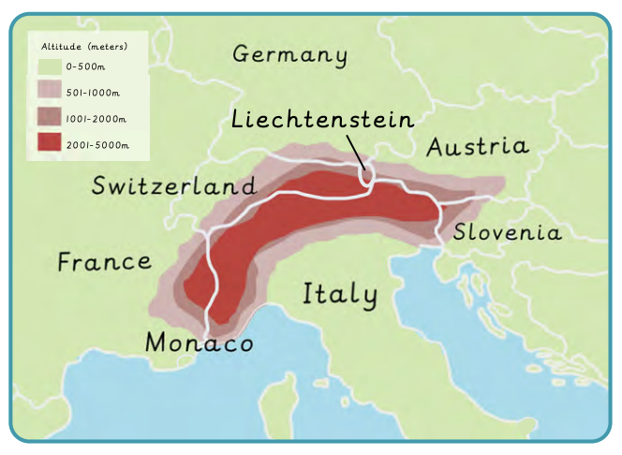
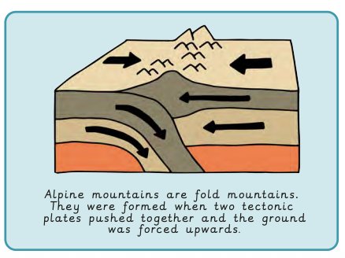
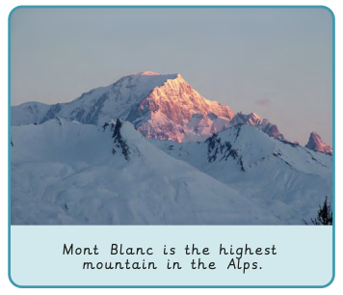
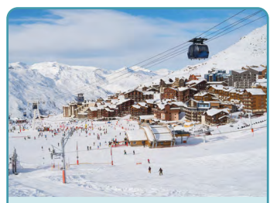
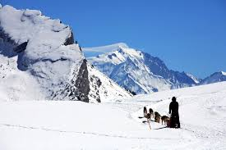
What is life like in the Alps? | Emerald | Geography | Autumn
What I should already know:
Identify water stores and the processes in the water cycle.
The physical features of a river from source to mouth.
Understand how people use a physical environment, such as a river.
What I will learn:
LO 1: Where are the Alps?
LO 2: What is it like in the Alps?
LO 3: Why do people visit the Alps?
LO 4: What is there to do in our local area?
LO 5: How are the Alps different to our local area?
LO 6: What is life like in the Alps?
Key Vocabulary:
climate | Long-term weather conditions in a specific region.
fold mountain | A mountain created when two tectonic plates are pushed together, pushing the ground upwards.
glacier | A slow-moving mass of ice formed by the accumulation of compact snow on mountains.
land height | The position of a point above sea level.
mountain climate | A region with a colder climate than the surrounding area, affected by the height of the mountains.
mountain range | A series of mountains located close together.
scale | The ration of the distance on a map to the distance on the ground.
sea level | The base level for measuring land height on Earth.
temperate | A region with mild temperatures
temperate deciduous forest | A biome that has many deciduous trees that drop their leaves in autumn.

