Slide 1

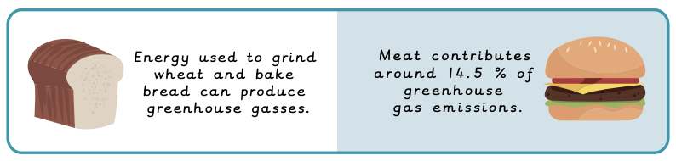

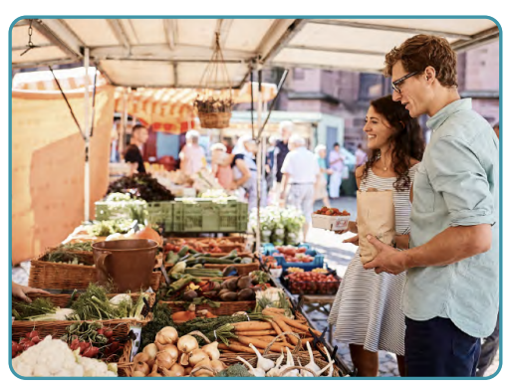
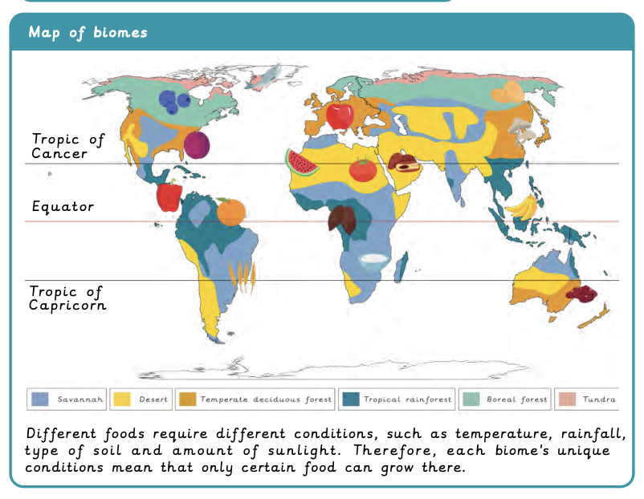

Where does our food come from? | Diamond | Geography | Summer
What I should already know:
Understand our local area including human and physical features and the weather.
How to interpret simple maps and locate specific places.
Understand that climate is different around the world and have an understanding about some places that differ.
What I will learn:
LO 1: How can our food choices impact the environment?
LO 2: What does it mean to trade responsibly?
LO 3: How do we get our chocolate?
LO 4: Where does our food come from?
LO 5: Are our school dinners locally sourced?
LO 6: Is it better to buy local or imported food?
Key Vocabulary
air freight | Products carried by aeroplanes.
carbon footprint | The amount of carbon dioxide released into the environment from an activity.
consume | To buy or use.
distribution | The way in which something is shared out.
fertiliser | A chemical added to soil to help plants grow.
food bank | A place that provides food for people who may need some extra help.
food miles | The distance food has travelled to reach you.
import | An item brought in from a different country.
pesticides | A substance used for killing or repelling bugs that may eat crops.
produce | Food which is grown on a farm to be sold.
reliability | How accurate a set of data is.
responsible trade | A process to ensure workers have a voice and the best conditions.
seasonal food | A food best harvested in a particular season.
sustainability | A way of doing something that does not harm the environment.
trade | The buying and selling of goods or services.

