Slide 1
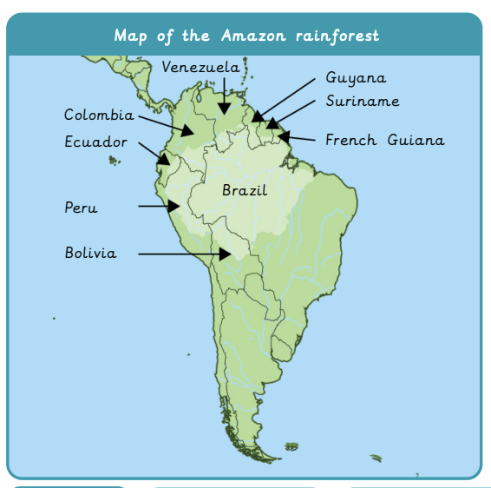
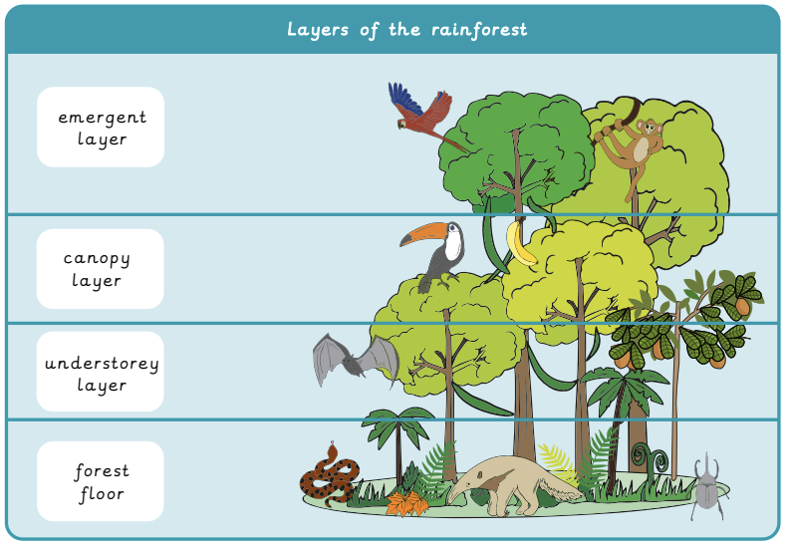
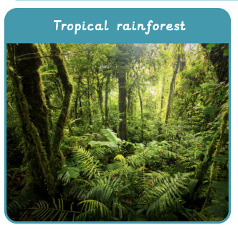
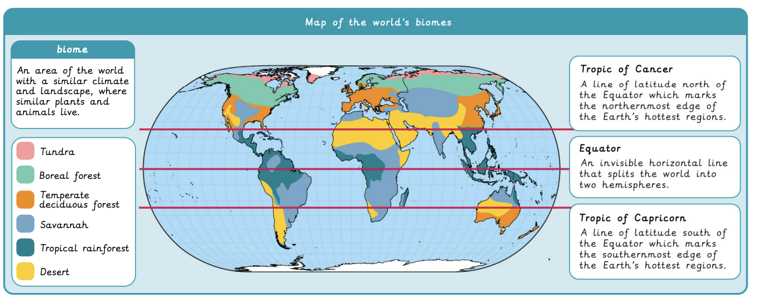
Why are rainforests important to us? | Diamond | Geography | Spring
What I should already know:
The names of the continents and oceans of the world.
How to use an atlas and interpret a map using the key and symbols.
Describe the weather in different places.
What I will learn:
LO 1: Where in the world are tropical rainforests?
LO 2: What is the Amazon rainforest like?
LO 3: Who lives in the rainforest?
LO 4: How are rainforests changing?
LO 5: How is our local woodland used? Data collection
LO 6: How is our local woodland used? Findings
Key Vocabulary
biome | An area of the world with a similar climate and landscape where similar plants and animals live.
deforestation | The cutting down of trees in a large area.
drought | A long period of time without rain in which living things begin to suffer.
global warming | When the Earth’s temperature rises because of greenhouse gases.
greenhouse gas | Gases in the atmosphere that trap heat from the sun and increase the temperature of our planet.
Indigenous people | People who lived in a country or a geographical region at the time when people of different countries arrived.
logging | The cutting down of tress for their wood.
mining | The process of digging up valuable minerals from the Earth’s crust.
vegetation | All the plants that grow in a certain area.
vegetation belts | Regions where similar plants grow, influenced by climate.

