Slide 1
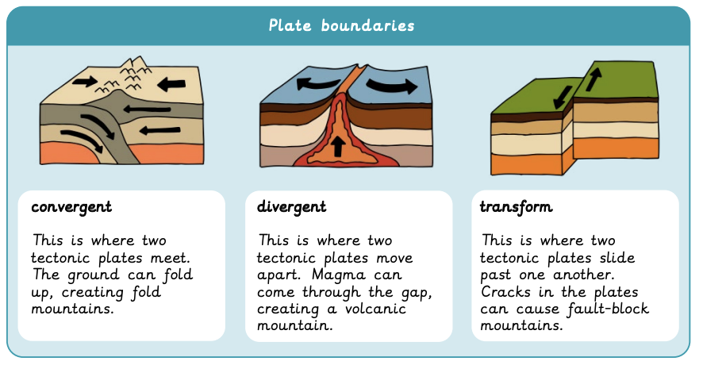
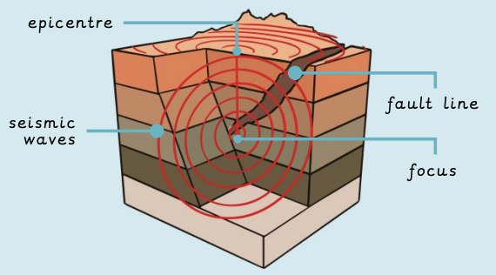
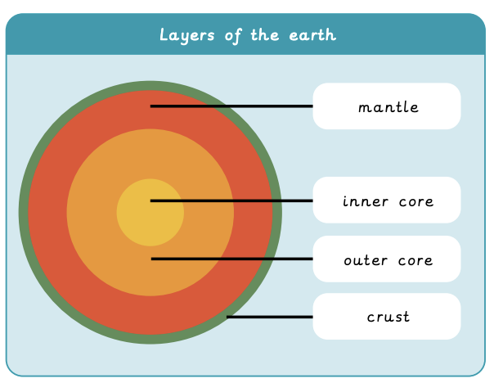
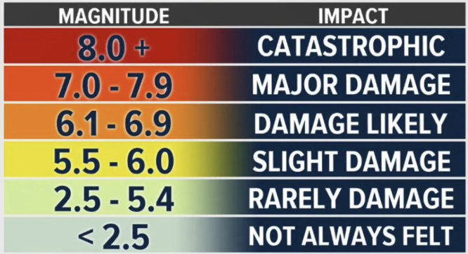
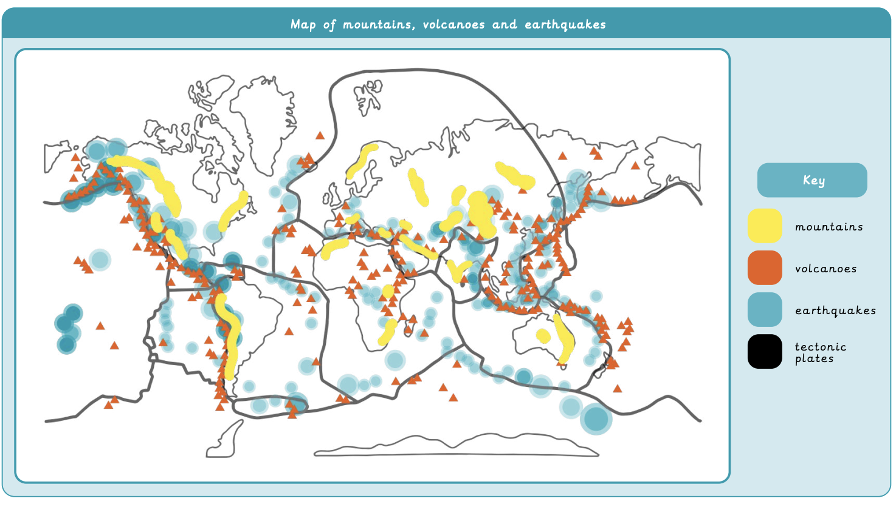
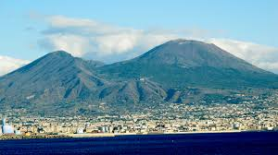
Why do people live near volcanoes? | Diamond | Geography | Autumn
What I should already know:
Examples of human and physical features
Describe the location of features using directional language
Name and draw compass points
What I will learn:
LO 1: How is the Earth constructed?
LO 2: Where are mountains found?
LO 3: Why and where do we get volcanoes?
LO 4: What are the effects of a volcanic eruption?
LO 5: What are earthquakes and where do we get them?
LO 6: Where have the rocks we have around school come from?
Key Vocabulary
active volcano | A volcano currently erupting or likely to erupt soon.
composite volcano | An explosive, steep-sided volcano.
dormant volcano | A volcano that may erupt again but has not erupted for a while.
earthquake | A shaking of the ground caused by moving tectonic plates.
extinct volcano | A volcano that has not erupted in 10,000 years and is not expected to erupt again.
geothermal energy | Energy created by the steam from a volcano.
pyroclastic flow | Rock, ash and gas that come out of a volcano and flow down the sides.
seismic waves | Waves of energy that move outwards and cause the ground to shake.
shield volcano | A less-explosive, gently sloping volcano.
tsunami | Large, dangerous waves caused by earthquakes.
volcanic springs | A pool of water heated by hot magma underground.

