Slide 1
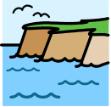
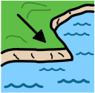
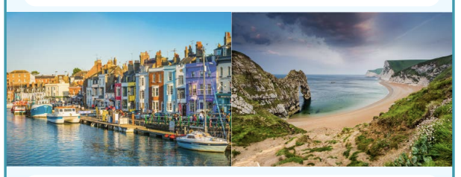

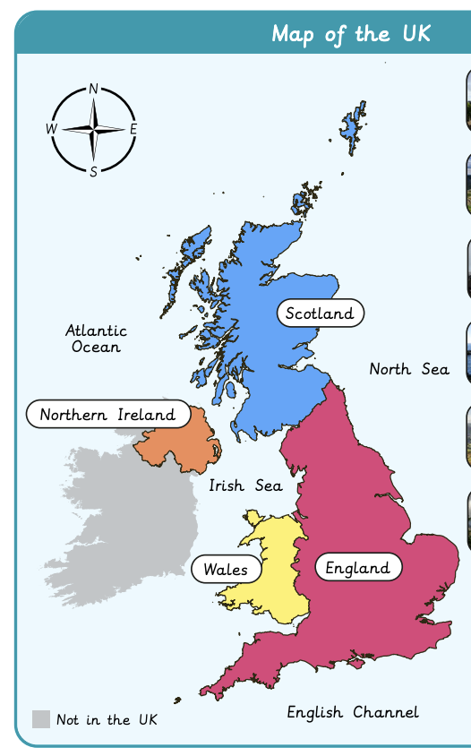
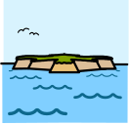
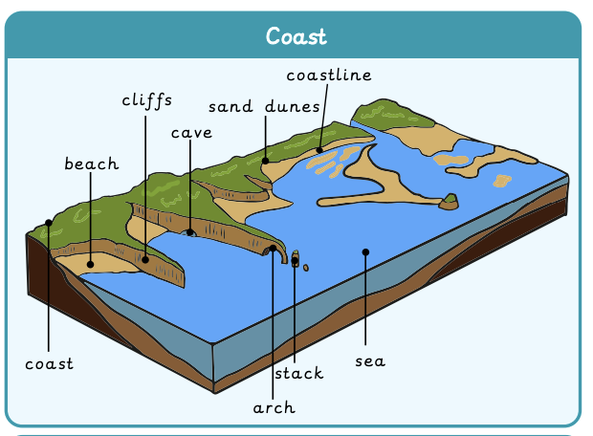


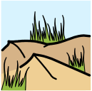

What can you see at the coast? | Sapphire Year A | Geography | Summer
What I should already know:
Identify the United Kingdom (UK) and its four countries.
Name and locate the 7 continents using an atlas and globe.
Describe the features of their local area based on what humans have created or what is naturally there.
What I will learn:
LO 1: What are some of the UK’s amazing features and landmarks?
LO 2: Where are the seas and oceans surrounding the UK?
LO 3: What is the coast?
LO 4: How do people use our local coast? Data collection
LO 5: How do people use our local coast? Findings
LO 6: Where are our oceans?
Key Vocabulary:
cliff |  | A steep rock face.
coast |  | A piece of land along the sea or ocean.
coastline |  | Where the sea meets the land.
fieldwork |  | Collecting data outside of the classroom.
island |  | An area of land surrounded by the sea.
landmark |  | An easily recognisable and possibly well-known feature.
ocean |  | A large body of salt water.
sand dunes |  | A mound formed by sand.
sea |  | A smaller body of salt water beside land.

