Slide 1


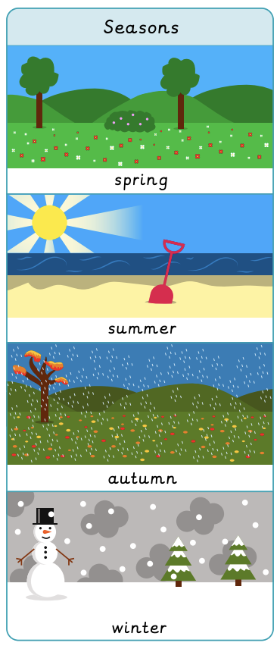

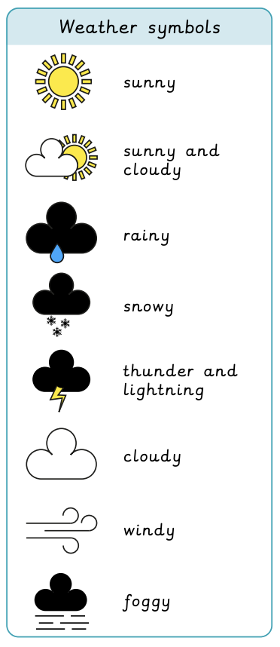
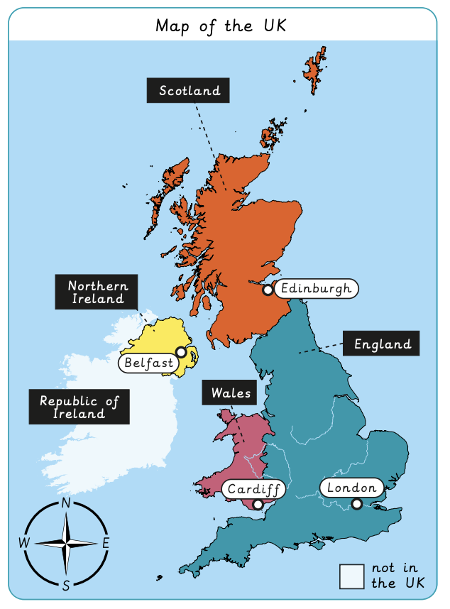

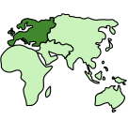


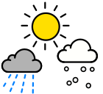
What is the weather like in the UK? | Sapphire Year A | Geography | Spring
What I should already know:
The names of key features in their local environment.
How to create a simple map of their surroundings.
Use locational words to describe their surroundings.
What I will learn:
LO 1: Where is the UK?
LO 2: What are the four seasons?
LO 3: What are the compass directions?
LO 4: What is the weather like today?
LO 5: Is the weather the same everywhere in the UK?
LO 6: How do people prepare for the weather?
Key Vocabulary:
atlas |  | A book of maps.
capital city |  | A city where the country’s government is located.
climate |  | The long-term weather conditions in a specific place.
compass |  | An instrument with a pointer showing the direction of magnetic north.
continent |  | A large land mass.
country |  | A land or nation with its own government.
season |  | One of four parts of a year, marked by the weather conditions.
weather |  | The short-term conditions in a particular place.

