Slide 1
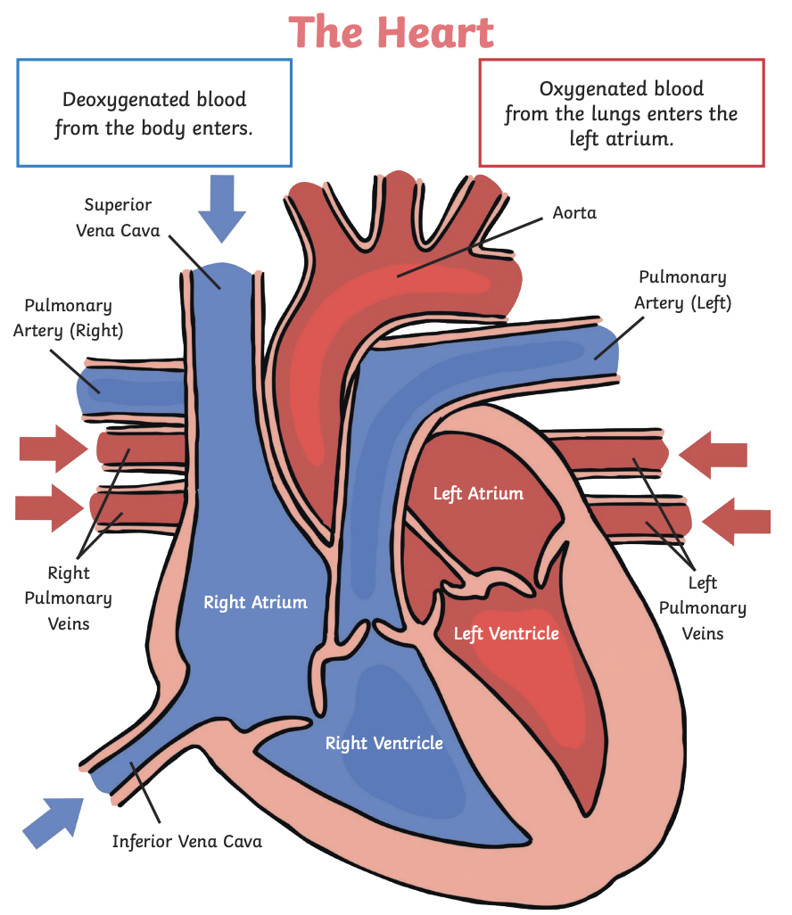
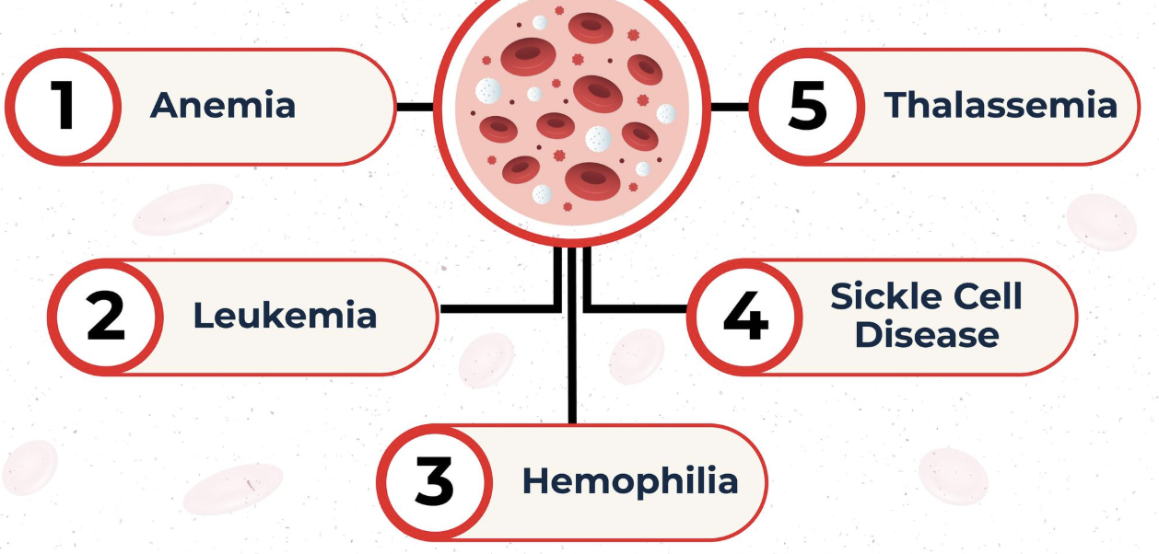





Animals including Humans | Emerald | Science | Autumn 1
What I should already know:
The function of a skeleton in humans and some animals
The functions of human teeth and the digestive system
How human development changes between birth and old age
What I will learn:
LO 1: What is the circulatory system?
LO 2: How does blood get around the body?
LO 3: What is in the blood?
LO 4: How do we get water and nutrients?
LO 5: How can we keep our heart healthy?
LO 6: What are some blood disorders?
Key Vocabulary:
arteries | The tubes that carry blood away from your heart.
blood pressure | The force of blood pushing against the walls of the arteries as blood pumps around the body.
cardiac muscle | The muscle that makes up your heart.
cholesterol | A type of fat found in your blood.
circulatory system | The network of the heart, blood and blood vessels.
plasma | A liquid that carries nutrients, water and sugar around the body.
platelet | Cells that help blood to clot and stop bleeding.
red blood cells | Cells that carry oxygen around your body.
valves | Prevent the backflow of blood.
veins | The tubes that carry blood back to your heart.
white blood cells | Cells that defend the body and help fight infections.
Scientists/Inventors:
William Harvey (1578 – 1657) Famous for his groundbreaking work on the circulatory system
Charles Drew (1904 - 1950) Surgeon and medical researcher known for his work on blood storage and transfusions.

