Slide 1

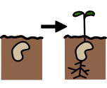
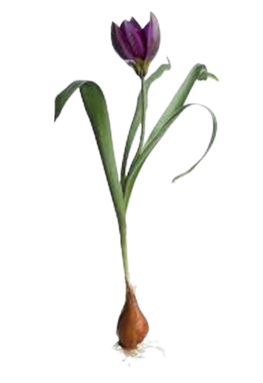
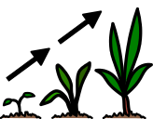
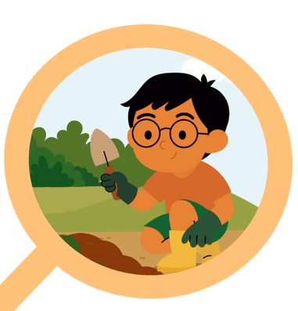


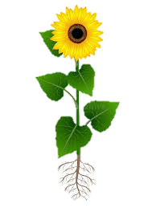

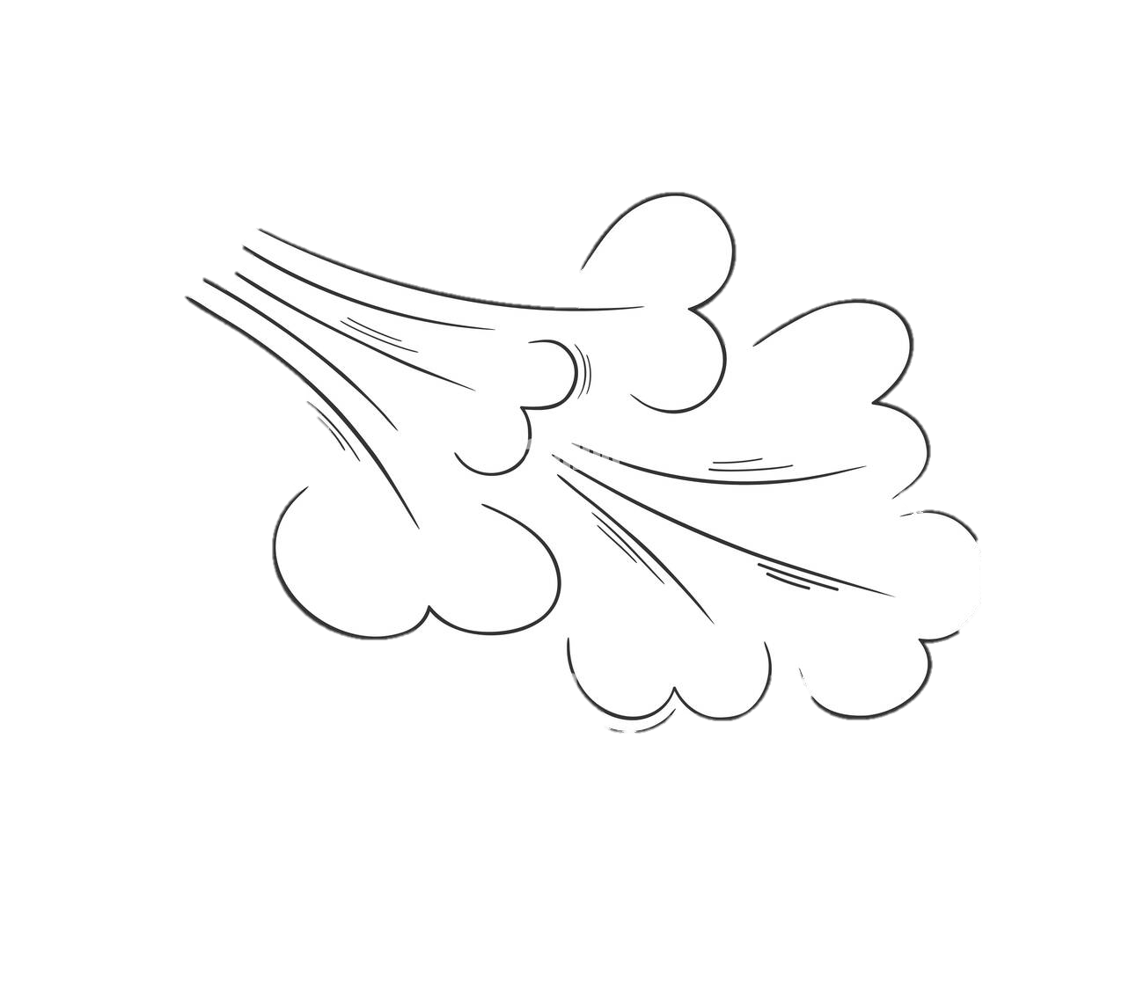

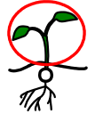





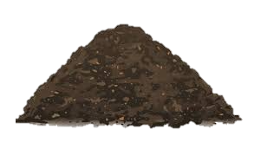
Plants | Sapphire | Science | Autumn 1
What I should already know:
Names of the seasons and noting the changes
Names of common plants and their parts
Observe plant growth over time
What I will learn:
LO 1: What are seeds?
LO 2: How do seeds grow?
LO 3: What are bulbs?
LO 4: How do bulbs grow?
LO 5: What do seeds and bulbs need to grow?
LO 6: Where do new plants come from?
Key Vocabulary:
bulb |  | A round part of a plant that is used to grow a new plant.
germinate |  | The process where a seed grows into a plant.
grow |  | A living thing (like a seed) that gets bigger over time.
light |  | Used by plants to make food to help them to grow.
seed |  | Part of a plant where new plants grow.
shoot |  | Part of a plant that grows above the ground.
temperature |  | A way to measure how hot or cold something is.
water |  | A clear liquid that is essential for life.

