Slide 1
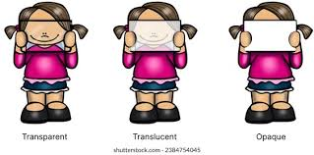
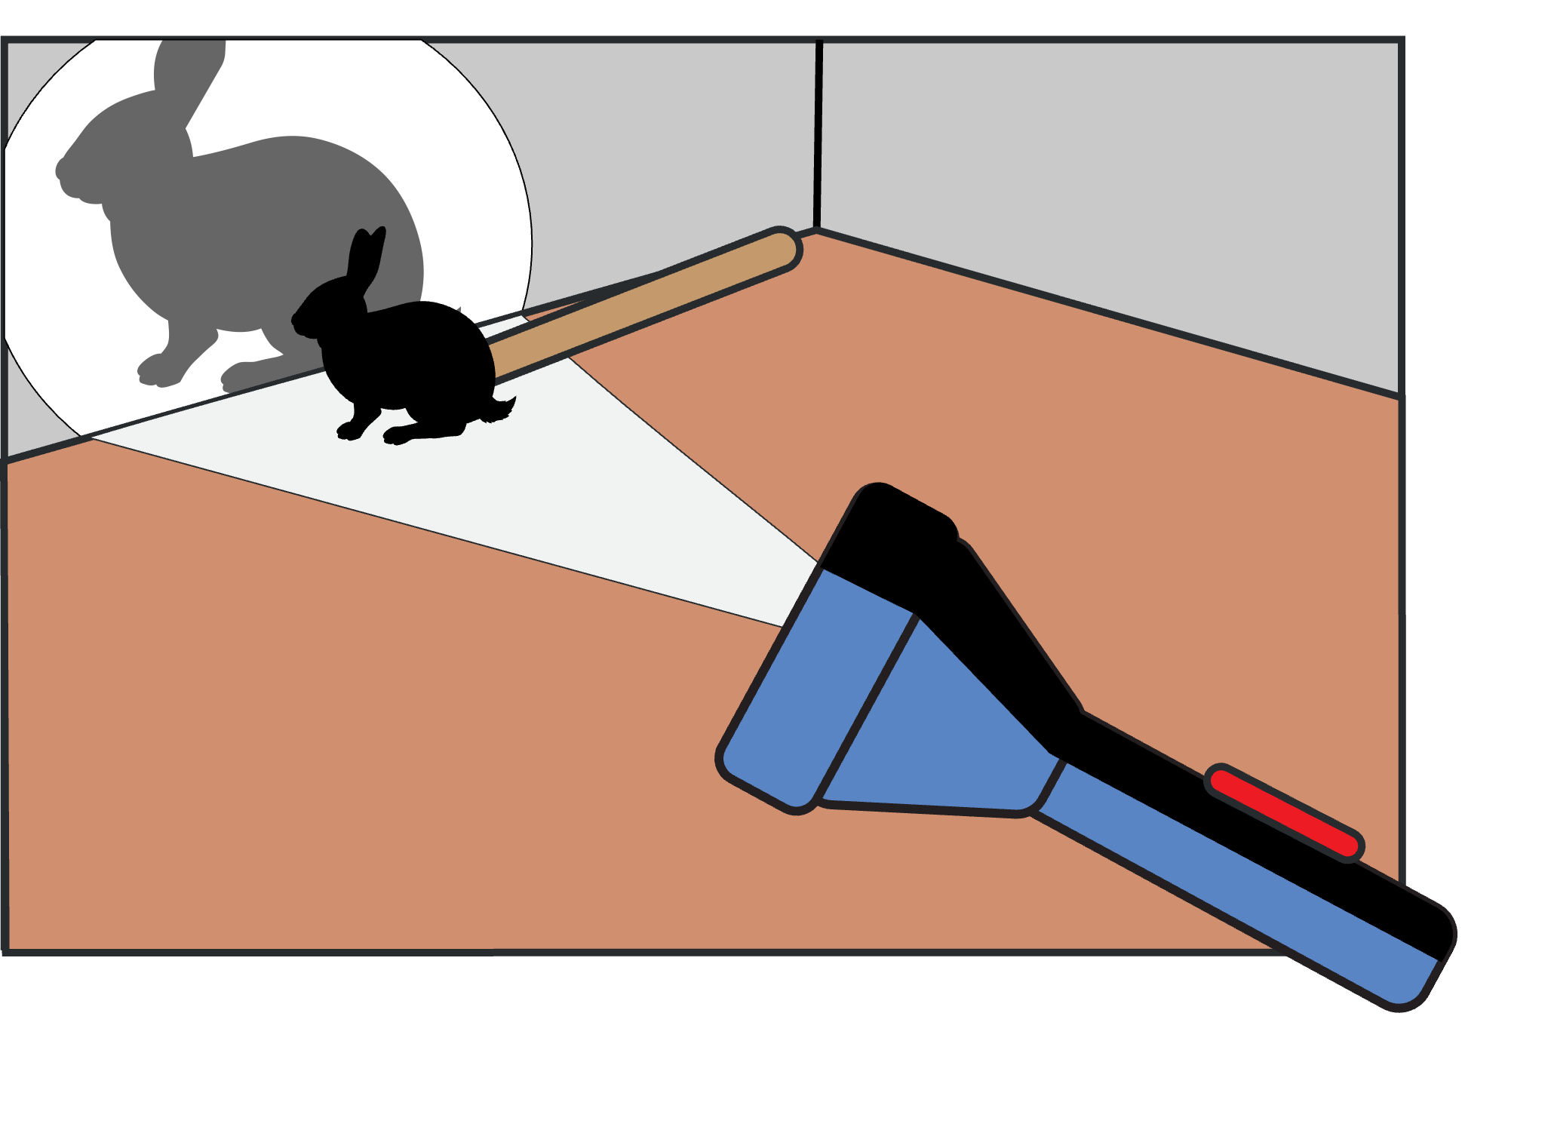
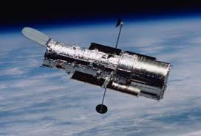
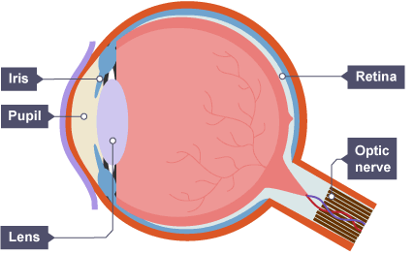


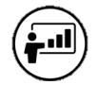

Light | Diamond | Science | Spring 1
What I should already know:
The identification of everyday materials and their properties.
Understand sources of light in relation to seasonal changes.
The properties of materials allow or block light.
What I will learn:
LO 1: Light source or light reflector?
LO 2: Transparent, translucent or opaque?
LO 3: What makes a good reflector of light?
LO 4: What is a shadow?
LO 5: How can we protect our eyes from the sun?
LO 6: How do telescopes work?
Key Vocabulary:
iris | The coloured part of your eye.
lens | A transparent piece of material shaped to refract light.
light source | An object that gives out its own light.
mirror | A smooth shiny surface that reflects light to create an image.
opaque | An object that does not allow any light to pass through it.
optician | A place where you get your eyesight tested.
pupil | The black hole in the middle of your eye that allows light to enter to help us see.
reflection | When light bounces off a surface and changes direction, allowing us to see objects.
shadow | A dark shape formed when an opaque object blocks the path of light.
telescope | An instrument that allows people to see distant objects.
translucent | A material that allows some light to pass through it but not all.
transparent | Materials that allow light to pass through them completely.
Scientists/Inventors:
Ibn al-Haytham (965AD – 1040) Known for his early studies in optics and light reflection.
Galileo Galilei (1564 – 1642) Responsible for advancements in telescope development.
Isaac Newton (1643 – 1727) Famous for his work on light composition and reflection principles.

