Slide 1
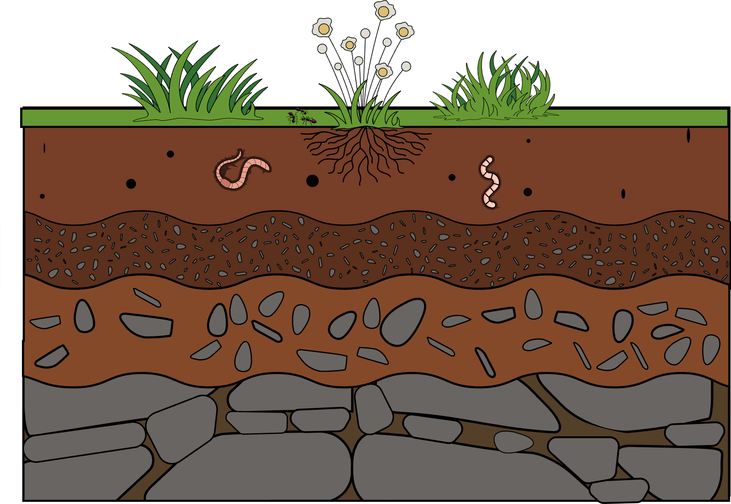
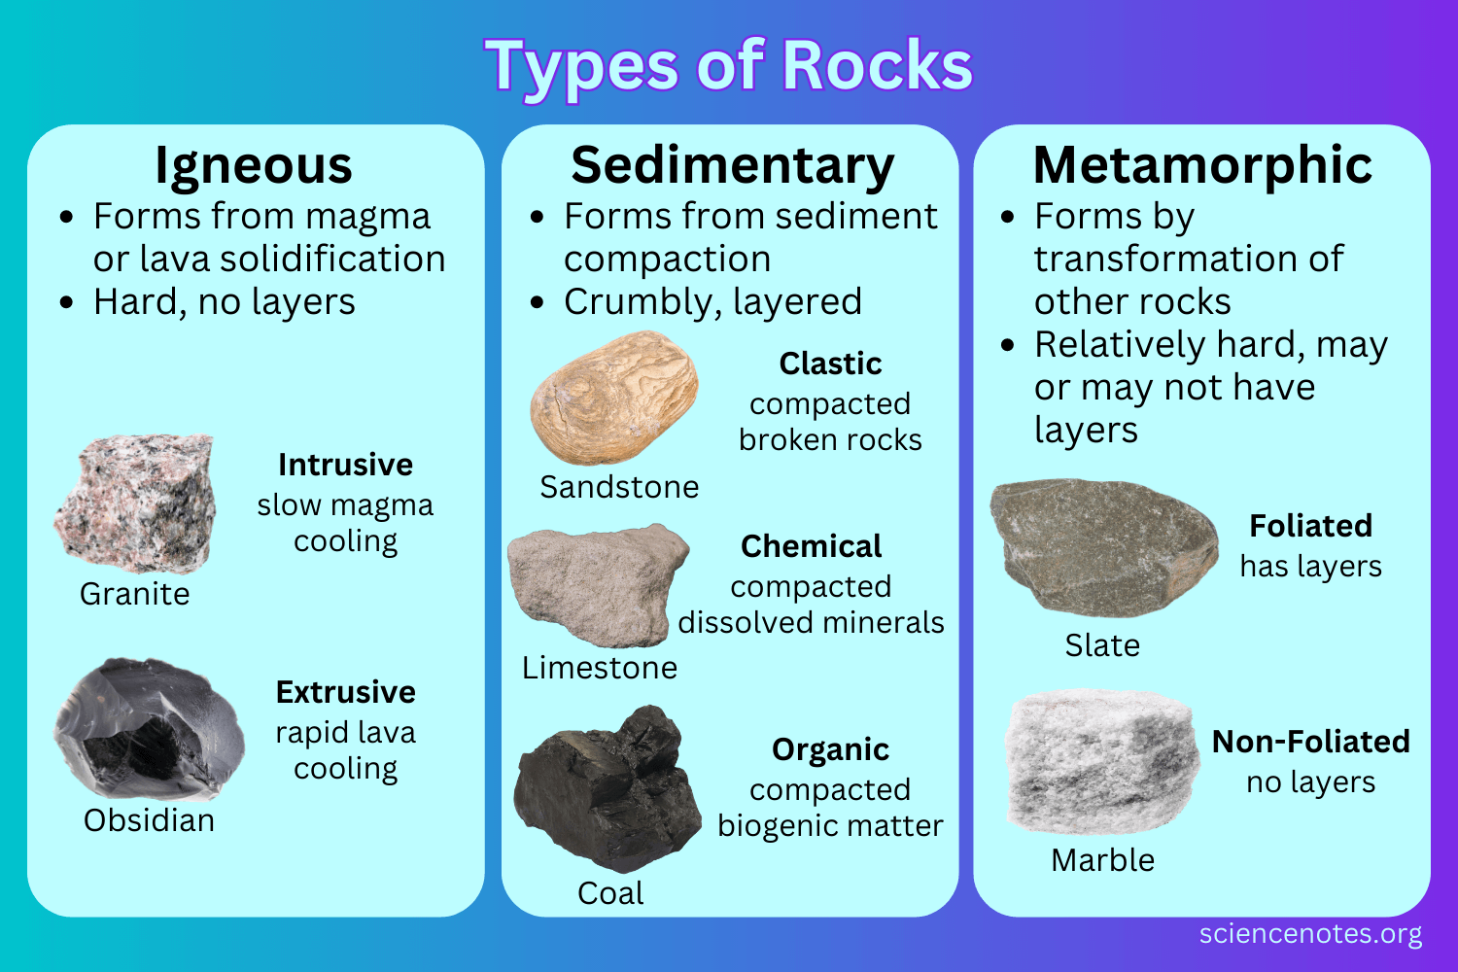


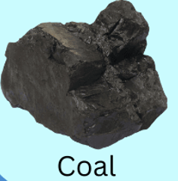


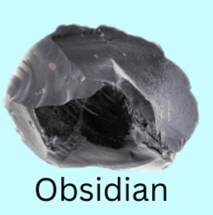
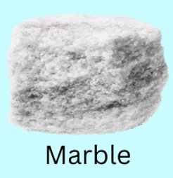
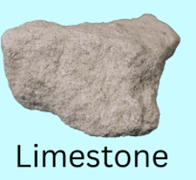
Rocks | Diamond | Science | Autumn 2
What I should already know:
That there are different materials.
That different materials do different jobs.
That materials have different properties
That materials can change shape, by squashing, rolling, bending, stretching or twisting.
What I will learn:
LO 1: What are some properties of rocks?
LO 2: How do volcanoes make igneous rocks?
LO 3: Where can we find fossils?
LO 4: Can rocks be changed?
LO 5: Can rocks be recycled?
LO 6: Why is soil important?
Key Vocabulary:
continents | A huge, continuous solid area of land.
fossil | The remains or impression of an animal or plant.
lava | Hot, liquid rock that has come out of a volcano onto the Earth’s surface.
magma | Molten or liquid rock found deep beneath the Earth’s surface inside volcanoes.
meteorologist | A scientist who studies the Earth’s atmosphere to understand and predict the weather and climate.
mineralogist | Scientists who study and investigate minerals.
palaeontology | The study of plants and animals that lived millions of years ago.
porosity | The amount of space within a material.
pressure | A measure of how much force is acting upon an area.
rock | A solid mass of minerals that have joined together over time. They are natural.
soil | Layer of the earth in which plants grow.
temperature | How hot or cold something is.
waterlogged | An area that is completely soaked or filled with water.
Scientists/Inventors:
Frederic Mohs (1773-1839) Mineralogist. Best known for developing the Mohs scale for mineral hardness.
Alfred Wegener (1880-1930) Astronomer and meteorologist. Famous for developing the theory of continental drift.
James Hutton (1726-1797) Geologist. Developed a theory that the Earth is very old and and constantly being reshaped. Known also for his observations of rock formation
A
B
C
D

