Slide 1
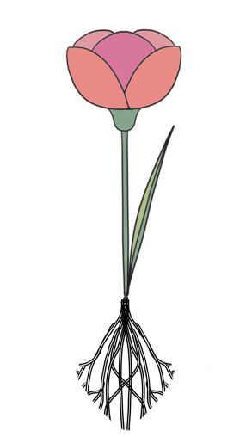
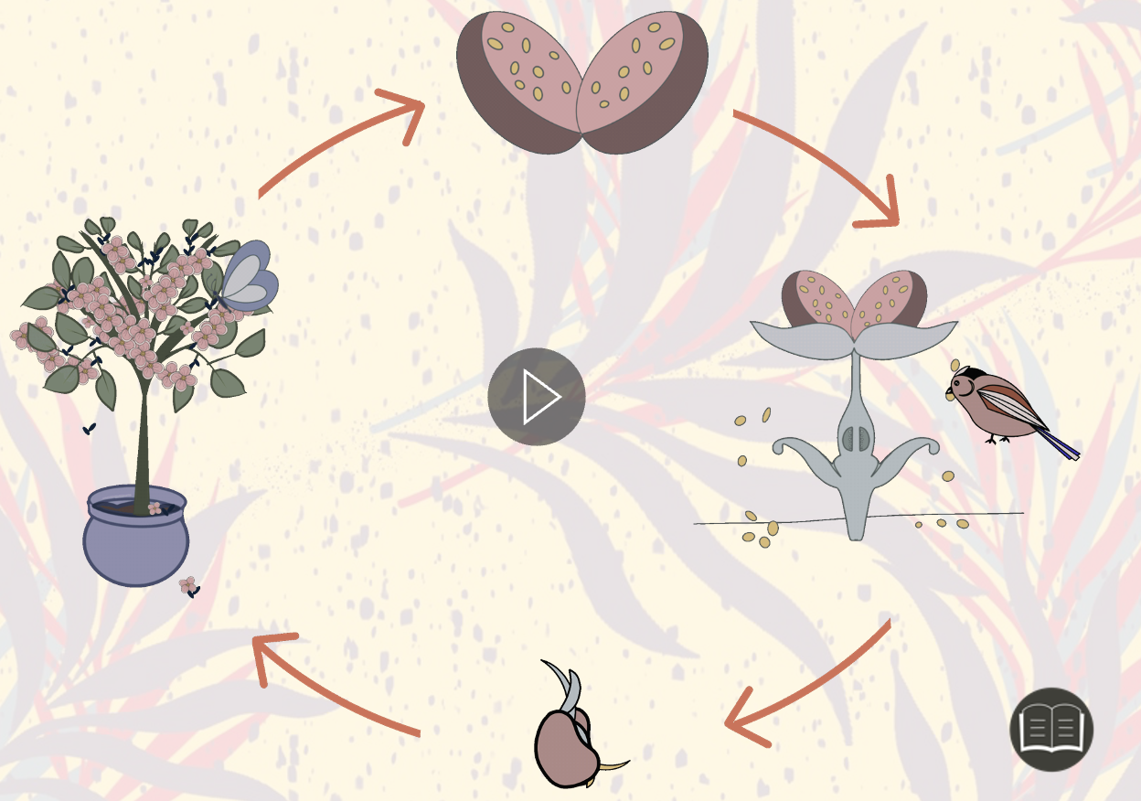








Plants | Diamond | Science | Autumn 1
What I should already know:
Some differences between living and non-living things
Names of different plants
What seeds look like as they grow
What plants need to grow
What I will learn:
LO 1: What are the parts of a plant?
LO 2: What do plants need to grow?
LO 3: How does water move around a plant?
LO 4: Why do plants need flowers?
LO 5: How do plants make new plants?
LO 6: What are the stages of a plant life cycle?
Key Vocabulary:
absorb | When a material takes in another material.
carbon dioxide | A colourless and odourless gas that is present in the air and is used by plants to help them grow.
fertilisation | The process of creating a seed within a plant.
fertiliser | A substance that contains nutrients that is added to soil to help make plants grow.
flowers | A part of a plant that is responsible for producing sees that grow into new plants.
germination | Part of the life cycle of a plant where seeds start to grow.
minerals | A naturally occurring solid such as limestone, clay or gold.
nutrients | Substances that nourish a plant.
pollen | A fine, powdery substance that is produced by the male parts of a flower. it is needed to create seeds.
pollination | The transfer of pollen from the male part of a flower to the female part of a flower.
Scientists/Inventors:
John Baptist Van Helmont (1580-1644) Carried out many experiments on plant growth
Mary Seacole (1805-1881) Famous for using plants as medicine to treat soldiers during the Crimean War

